Slide 1
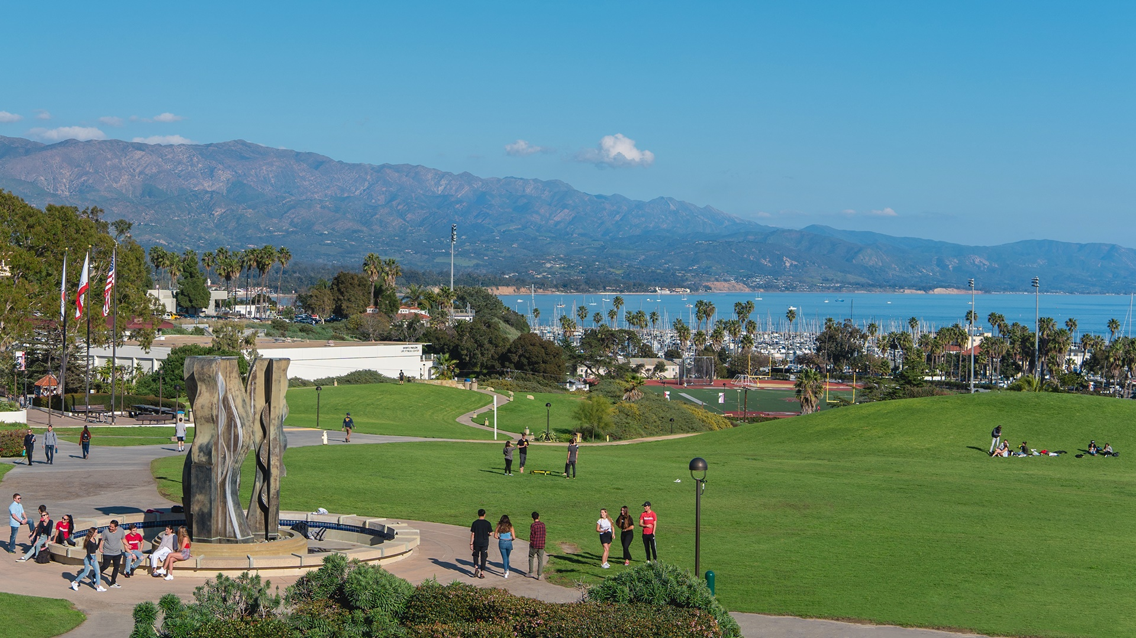


SANTA BARBARA CITY COLLEGE
LONG RANGE FACILITIES
MASTER PLAN 2024
December 13, 2023

Slide 2
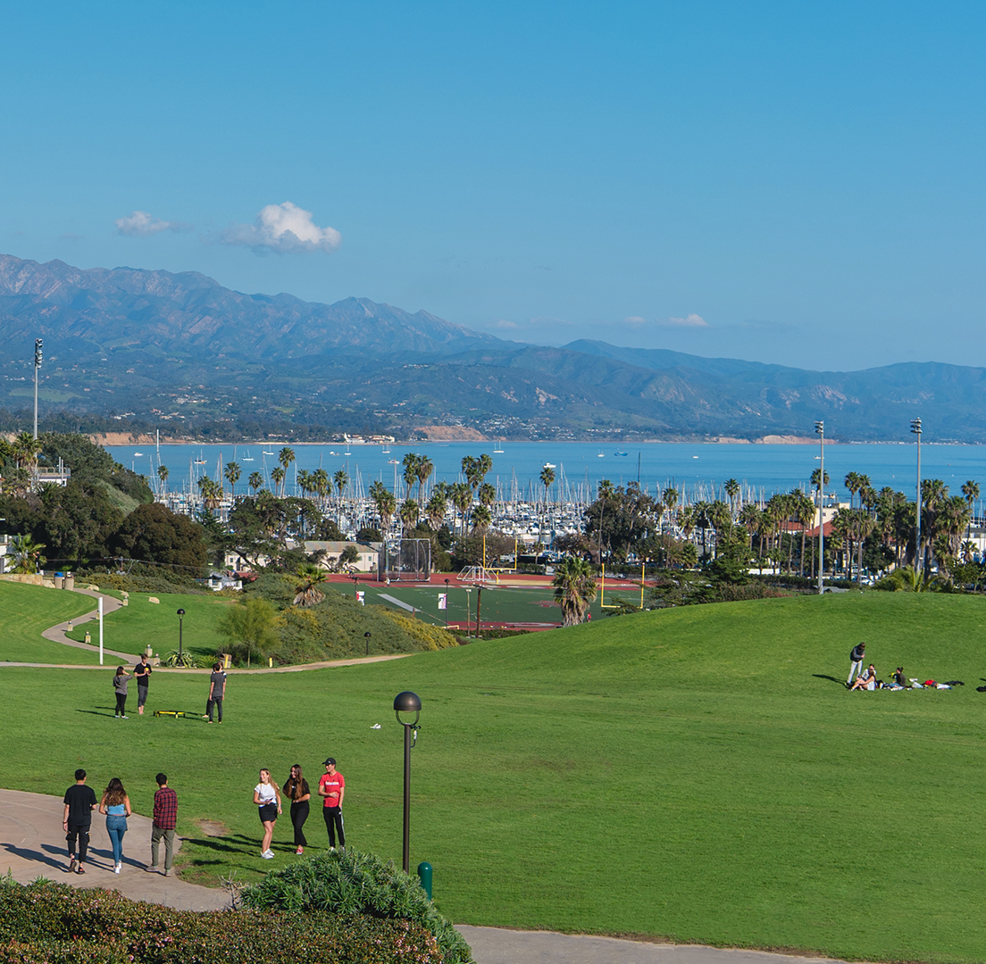

AGENDA
INTRODUCTIONS
GOALS / OBJECTIVES
WHAT IS AN FMP
PROCESS / SCHEDULE OUTLINE
NEXT STEPS
LONG RANGE FACILITIES MASTER PLAN

Slide 3

INTRODUCTIONS
CWP TEAM
SBCC TEAM
LONG RANGE FACILITIES MASTER PLAN

Slide 4

The intent of this discussion is the "forest, not the trees". We are looking for a discussion of what is important in the planning of the campus as a whole - facilities, infrastructure, open space, etc. We are looking for ideas beyond the detail of "I need a sink here" or "an outlet there", this is an opportunity to express what is important to you in the planning of your campus to support student success.
LONG RANGE FACILITIES MASTER PLAN
4

Slide 5
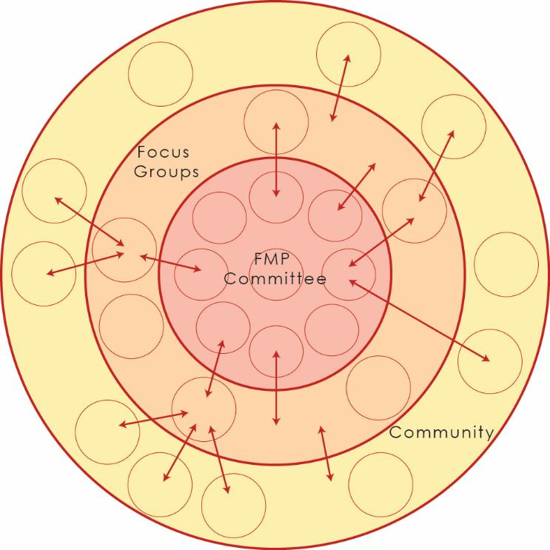
WORK GROUP ROLE
Facilities Planning Work Group
  Engage in Discussion
  Disseminate information, gather feedback
  Direction and Recommendations
Focus Groups
  Input and Feedback
  Build Support Internally
LONG RANGE FACILITIES MASTER PLAN
5

Slide 6
EDUCATIONAL PLANNING
COMPREHENSIVE
MASTER PLAN
(OUTCOMES)
Links the EMP and FMP
Implementable
Linked to Capital Outlay Plan
Tied to the institutional objectives
Leverages State & Local Dollars
Appropriate Sequence / TCO
Supported by the Campus & Community
Embraces the Mission
Pathway for Bond Program
Outreach / Engagement
QUALITATIVE
QUANTITATIVE
(DATA DRIVEN)
FACILITIES
PLANNING
LONG RANGE FACILITIES MASTER PLAN
6

Slide 7
GOALS & OBJECTIVES
LONG RANGE FACILITIES MASTER PLAN

Slide 8
GOALS
Provide a vision
for SBCC that is data driven, increases efficiency, and supports the academic mission
Provide a blueprint for campus development and a resource for decision making
Fiscal & Environmental
Sustainability
LONG RANGE FACILITIES MASTER PLAN
8

Slide 9



GUIDING PRINCIPLES & OBJECTIVES
BROADEN DEFINITION OF SUSTAINABILITY
  Environmental + Community + Financial
IMPROVE UTILIZATION OF CAMPUS
  Improve zoning/ space utilization
  Maximize functional space
    Provide multipurpose, hi-flex, resilient spaces
  Eliminate non-functional space
ENHANCE STUDENT SUCCESS
  Support Student access
    Physical access (Universal Access Principles)
    Services & Student life
  Balance and support socialization and formal learning
  Maintain student safety
LONG RANGE FACILITIES MASTER PLAN
9

Slide 10
PLANNING OUTCOMES
Fiscal Responsibility
Space requirements addressed for the future
Frames future development and the continued evolution of the campus, including:
  Identification of specific building / facilities programs
  Identification of repurposed / renovated / replaced / new facilities
  Identification of enterprise / joint use opportunities
  Improvement of major campus systems
  Identification of needed site amenities
Identify phases, timeline, and cost for Master Plan implementation
LONG RANGE FACILITIES MASTER PLAN
10

Slide 11
WHAT IS AN FMP?
FACILITIES MASTER PLAN
PROCESS
SCHEDULE
LONG RANGE FACILITIES MASTER PLAN

Slide 12
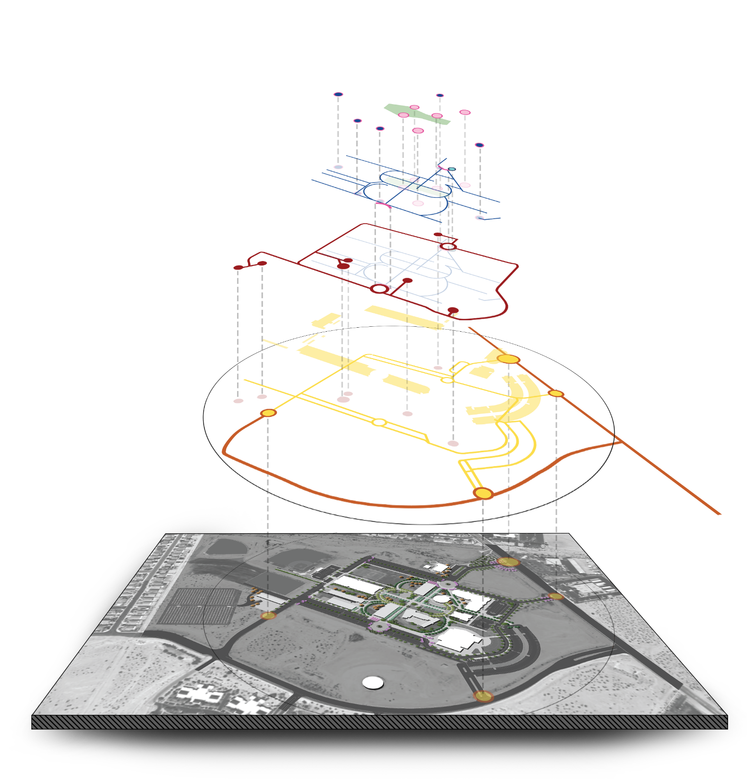
ASSESSING SYSTEMS
Open Space
Highest & Best Use of Existing & Planned Facilities
Campus Zoning
Vehicular Access & Circulation
Parking
Public Transportation
Utilities & Infrastructure
Pedestrian Circulation
Open Space Character
Sustainability
Project Sequencing
Pedestrian Circulation
Service
Parking
Vehicular Circulation
Facilities
College
LONG RANGE FACILITIES MASTER PLAN
12

Slide 13



PROCESS
LISTEN
INTERPRET/
CHALLENGE
VISUALIZE & BUILD CONSENSUS
LONG RANGE FACILITIES MASTER PLAN
13

Slide 14

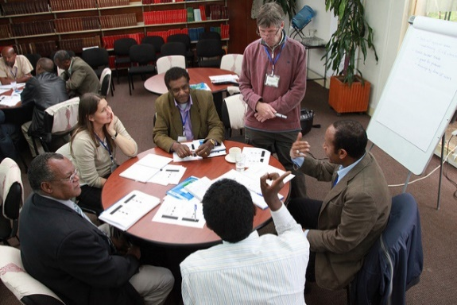
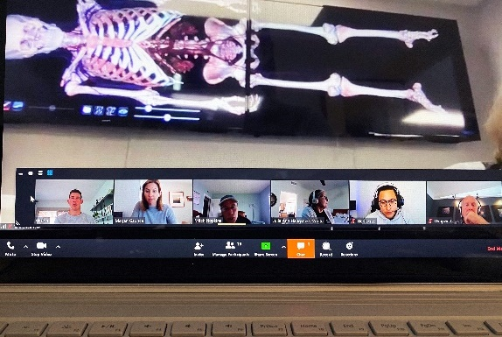
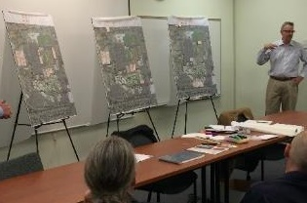
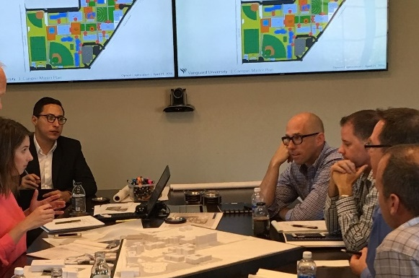

PROCESS | ENGAGEMENT
Surveys
Small Group Discussions
Online Meeting
Workshops
Hands-On Exploration
Community Outreach
LONG RANGE FACILITIES MASTER PLAN
14

Slide 15
SCHEDULE
Review of Current Plans & Documents
  Current EMP’s
  Current FMP’s
  5 year Capital Outlay Plan
  Landscape / Wayfinding / etc.
  LRDP / Land Use Restrictions
Total Cost of Ownership
Analyze Space Utilization
Facilities Condition Index
M&O / Facilities Team Site Analysis
Site Walk, Observations, & SWOT Analysis
Orientation & Facilities Assessment Review | Fall 2023
Quantitative Findings Presentation | Jan. 2024
Interviews / Internal Discussions | Feb 2024
SWOT Review & Initial Planning Discussion | March 2024
Develop Facilities Plan Draft(s) | April –May 2024
LONG RANGE FACILITIES MASTER PLAN
15

Slide 16
NEXT STEPS
Complete meeting calendar through June 2024 (prior to next meeting)
Set and conduct user group meetings (prior to next meeting)
Present initial quantitative findings (January 2024)
LONG RANGE FACILITIES MASTER PLAN

